Slide 1
CM4044 Project 2
Prediction for
melting point
Benjamin Chan Sin Teck (U1940715L)
Carl Neo Dun Qi (U1940041G)
Chia Yee Sheun (U1940627E)

Slide 2
TABLE OF CONTENTS
01
Dataset
04
Recursive Feature Elimination
02
Data Cleaning
05
Results
03
Generating
Descriptors
06
Conclusion

Slide 3
Significance and Objectives
Significance
Objectives
Predicting melting points is important in medicinal, environmental, and in development of green chemistry and ionic liquids
Complexity of structure of drug molecules makes it difficult to model
Lack of availability of data on which molecular descriptors are more significant in determining melting point
Predict melting point of drug-like molecules using the “Bradley set” of 3041 compounds
Apply Recursive Features Elimination (RFE) to select best features
Compare the performance of various machine learning models
Notes:
Predicting melting points (MPs) is very important for medicinal and environmental chemistry, as the MP is frequently used as one of the parameters to estimate the solubility of chemical compounds by means of Yalkowsky general solubility equation (GSE) (1) or/and similar approaches

Slide 4
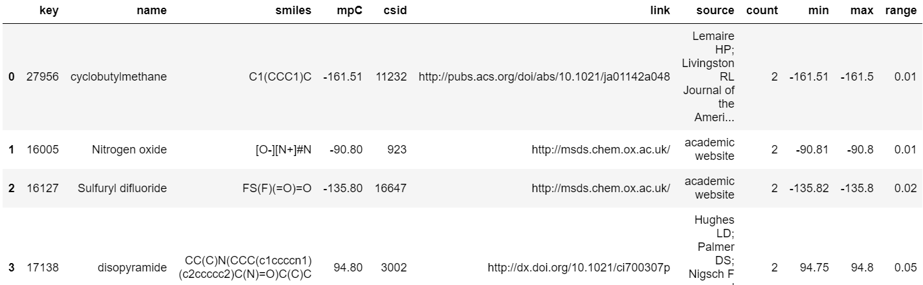
Choice of Dataset
Jean and Bradley melting point dataset, 3041 drug-like compounds

Slide 5
DATA
CLEANING

Slide 6
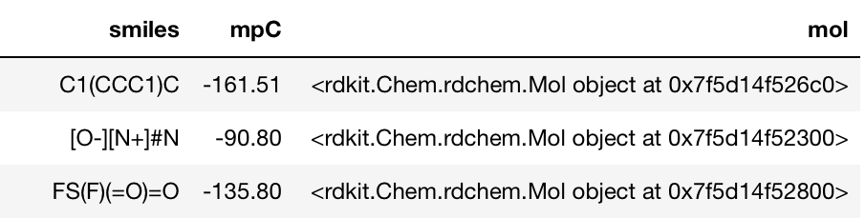
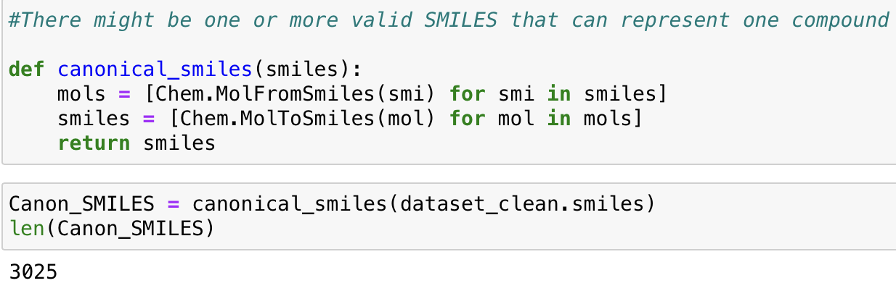
1
Removing Unnecessary Columns
2
Generating Mol from Smiles
Removal of 17 compounds due to Smiles being in wrong format
3
Generating Canonical Smiles
4
Removing duplicates Smiles

Slide 7
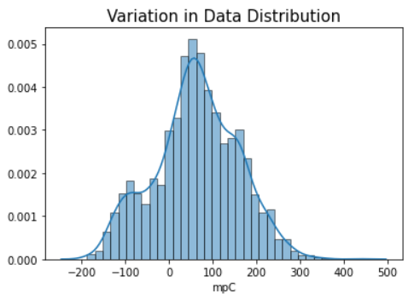
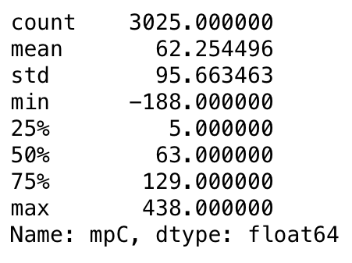
Data Inspection

Slide 8
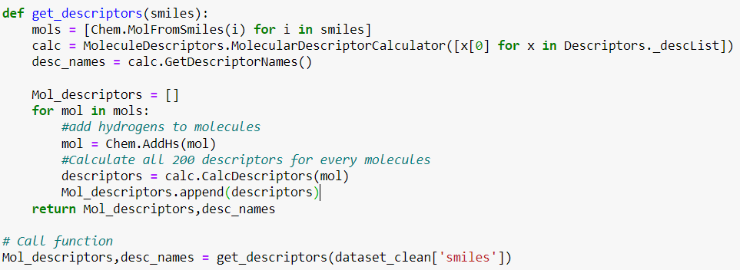
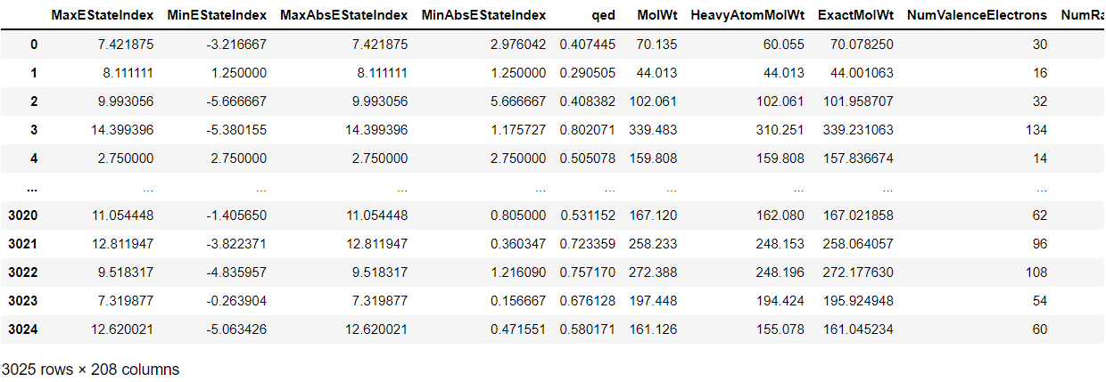
Generating RDkit Descriptors
General molecular descriptors-about 208 molecular descriptors
  Iterative method (For loop)
Notes:
This slide has animation

Slide 9
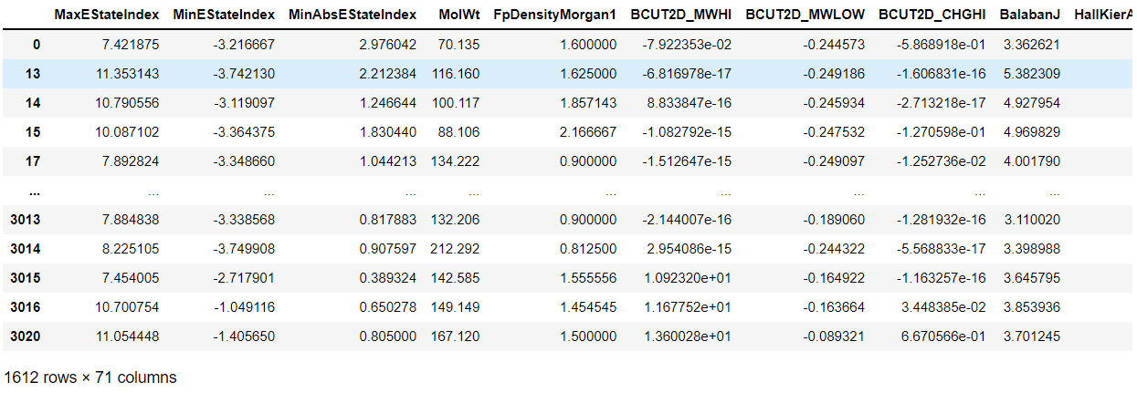
Cleaning RDkit Descriptors for RFE
Remove highly correlated features >= 0.7
Removal of low variance features
Removal of outliers
After cleaning: 71 molecular descriptors

Slide 10
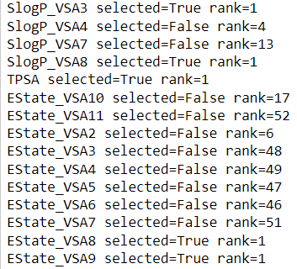


Recursive Feature Elimination
Takes input from user
05
Ranks Features
Features with rank 1 are the final features to be selected
01
01
04
Rebuild model with remaining features
Fits data with all features
02
03
Removes Least Important Features one at a time
Repeats the process until n features are met

Slide 11
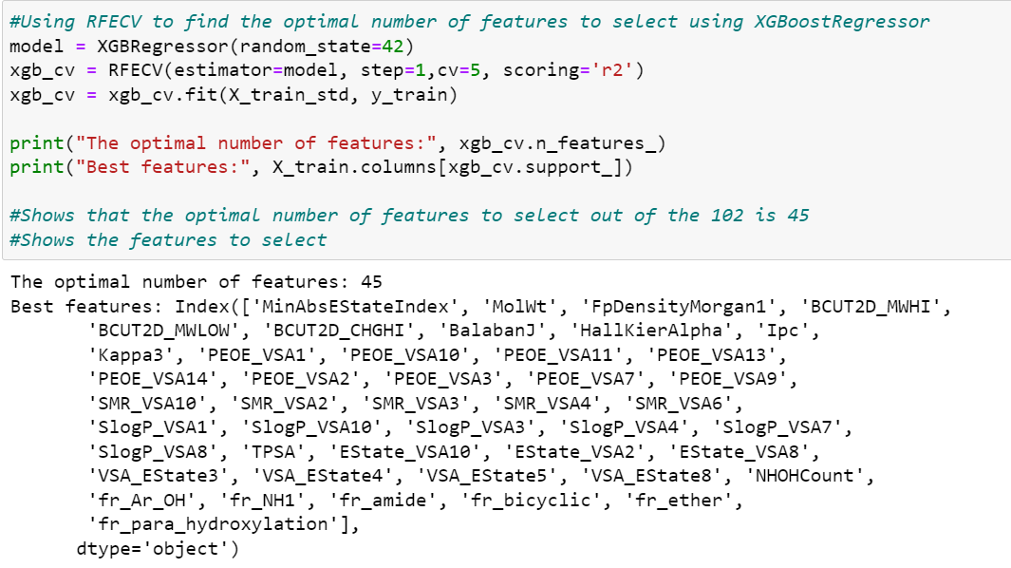
Recursive Feature Elimination Cross Validation(RFECV)
Challenge
  For RFE class, the optimal number of features to select is not always known
Luckily…
  SKlearn provided us with the RFECV class
    Implement the RFE together with Cross-validation
    Automatically Select the optimal number of features
Example: XGBoost Regressor with RFECV

Slide 12
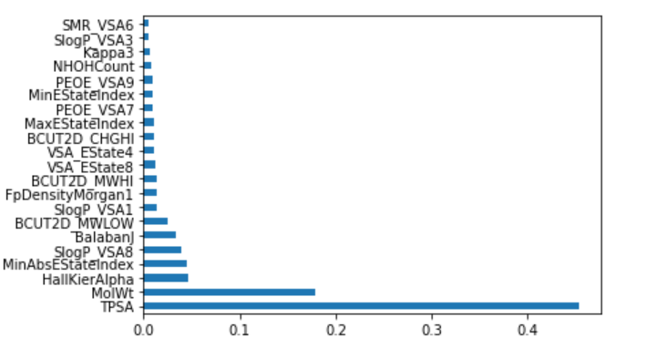
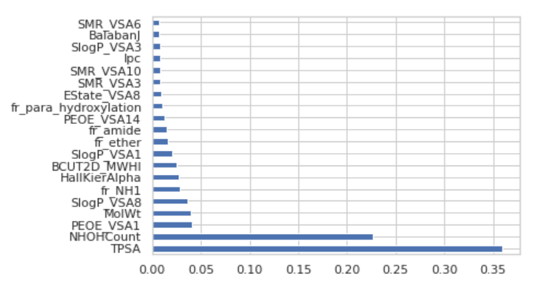
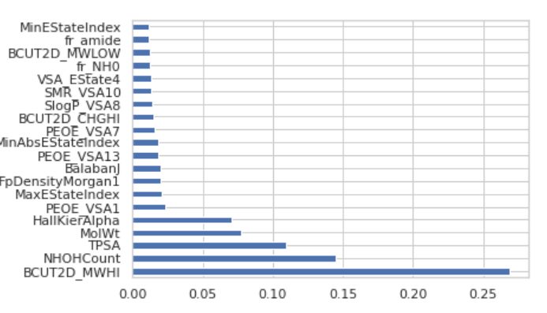
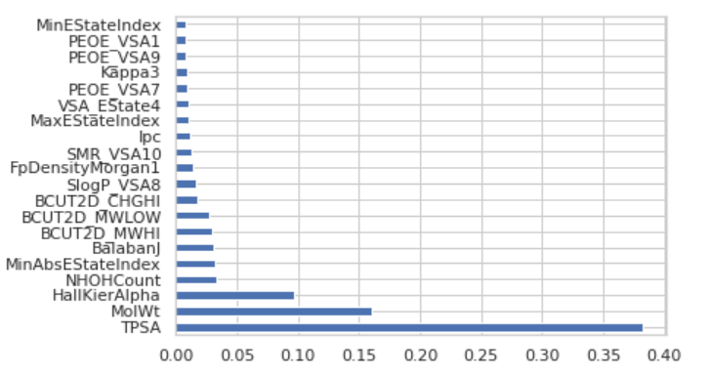
Summary of features importance wrt melting point
To interpret melting point model features (descriptors), need to show the feature importance of descriptors
Decision Tree Regressor
XGBoost Regressor
ExtraTreeRegressor
Random Forest Regressor

Slide 13
Summary of features importance wrt melting point
Common Descriptor: Topological Polar Surface Area
  Defined as the combined surface area belonging to oxygen and nitrogen atoms and hydrogen atoms bound to these electronegative atoms.
  The polar surfaces are able to have physical interactions such as H-bonding and dipole-dipole interactions.
Common Descriptor: Molecular Weight
  In general, Melting Point increases as molecular weight increases due to an increase in London dispersion forces
Common descriptor: NHOH Count
  Defined as the number of NHs and OHs
  An increase in the NHOH Count increases melting point due to the ability to form strong H-Bonds

Slide 14
Machine Learning Models
Decision Tree Regression
Traditional Machine Learning
Random Forest Regression
XGBoost Regression
Machine Learning
Extra Tree Regression
Deep Learning
Keras Neural Network

Slide 15
Cross Validation Comparison
5-Fold Cross validation (scoring = R²)
Results | Decision Tree Regression | Random Forest Regression | Xgboost Regression | Extra Tree Regressor
CV Score | 0.6614 | 0.8452 | 0.8401 | 0.8357

Slide 16
Model Comparison (Before Tuning)
Results | Decision Tree Regression | Random Forest Regression | Xgboost Regression | Extra Tree Regressor | Keras Neural Network
R² | 0.5620 | 0.8109 | 0.8093 | 0.8367 | 0.8302
RMSE | 59.878 | 39.688 | 39.510 | 36.563 | 37.279
MAE | 44.084 | 28.714 | 30.526 | 27.140 | 26.836

Slide 17
Model Comparison (After Tuning)
Results | Decision Tree Regression | Random Forest Regression | Xgboost Regression | Extra Tree Regressor | Keras Neural Network
R² | 0.6679 | 0.7438 | 0.8077 | 0.8375 | 0.8402
RMSE | 52.143 | 45.801 | 39.676 | 36.473 | 36.160
MAE | 38.592 | 35.245 | 31.056 | 27.459 | 26.542

Slide 18

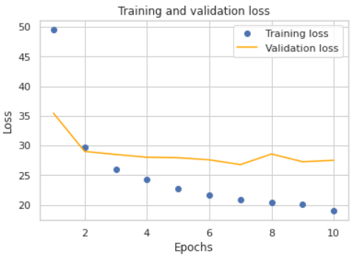
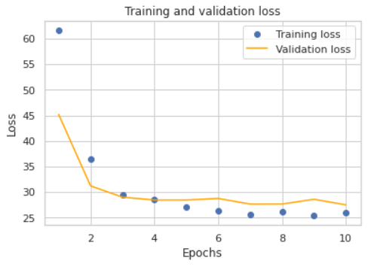

Slide 19
Best Model?
Results | Extra Tree Regressor | Keras Neural Network
MAE | 27.459 | 26.542
RMSE | 36.473 | 36.160
In terms of Traditional Machine Learning Method, XGBoost Regression is the better choice.
However, in terms of best overall performance, the Keras Neural Network is the best to predict the melting point of the drug compounds.

Slide 20
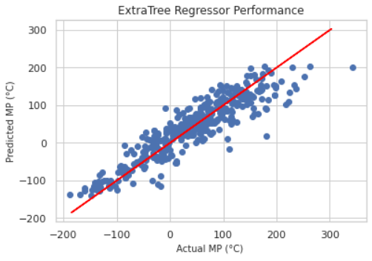
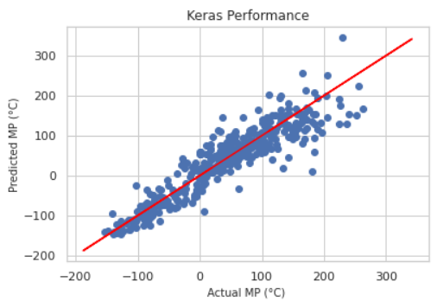
Model Comparison
Extra Tree Regression |  | Keras Neural Network
R² 0.8375 |  | R² 0.8402
Both model showed similar performance
For traditional method, Extra Tree performed the best
Keras has a slightly higher R² score
Notes:
In terms of Traditional Machine Learning Method, ExtraTree is the better choice.
However, in terms of best overall performance, the Keras Neural Network is the best to predict the melting point of the drug compounds.

Slide 21
Limitations
Even though Keras Neural Network performed slightly better
  Do not impose restrictions on features or data r/s
  May lead to combined features and hidden r/s that are not easily explained
  Example, NN may combine several descriptors to create a new feature that minimize error and does not directly correlate with a molecule’s physical characteristic
  Unable to use RFE for feature selection in Keras Neural Network
Notes:
Even though Keras Neural Network perform better than XGboost model
Do not impose restrictions on input variables/data r/s
May lead to combined features and hidden r/s that are not easily explained
Example, NN may combine several molecular descriptors to create a new feature that minimize error and does not directly correlate with a molecule’s physical characteristic
Many NN do not show correlations between features and property made during drug development.
As a result, a whole field of research has been dedicated to understanding their hidden r/s and model structure.

Slide 22
Conclusion and Future Work
Feature selection is still critical for developing interpretable and accurate predictive models.
  One method is to utilize RFE which was referenced from Ana. et.al.
  Allows researchers to identify dominant chemical- structure features based on ranking.
Opt to use Mordred Descriptors
  Able to calculate more than 1800 2D and 3D descriptors
  Applicable for large molecules, better performance
Notes:
Feature selection is still critical for developing interpretable and accurate predictive models.
One method is to utilize RFE which was referenced from Ana E.Comensana et.al.
Allows researchers to identify dominant chemical- structure features based on ranking that can impact molecules property value.
Opt to use Mordred Descriptors
Can Calculate more than 1800 2D and 3D descriptors
Has Good performance, able to calculate descriptors for large molecules
A promising choice of molecular descriptor calculation software that can be utilized for cheminformatics studies, such as those on quantitative structure–property relationship

Slide 23
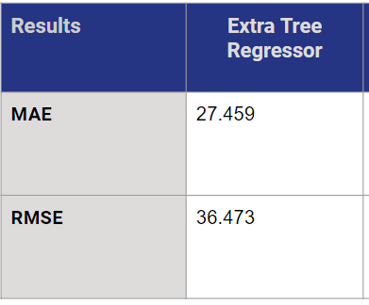
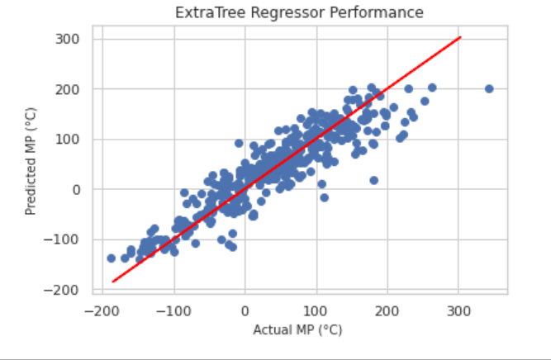
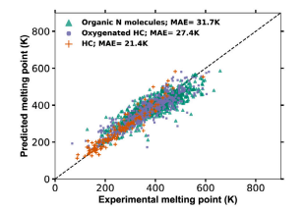
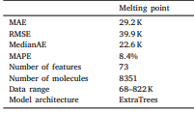
Comparison - Literature and Project Results
RDkit
Descriptors
Extra Tree Regressor
Mordred
Descriptors
Extra Tree Regressor
Cited from: A systematic method for selecting molecular descriptors as features when training models for predicting physiochemical properties

Slide 24
THANK YOU
Notes:
Even though Keras Neural Network perform better than XGboost model
Do not impose restrictions on input variables/data r/s
May lead to combined features and hidden r/s that are not easily explained
Example, NN may combine several molecular descriptors to create a new feature that minimize error and does not directly correlate with a molecule’s physical characteristic
Many NN do not show correlations between features and property made during drug development.
As a result, a whole field of research has been dedicated to understanding their hidden r/s and model structure.

Slide 25
References
Comesana, Huntington, T. T., Scown, C. D., Niemeyer, K. E., & Rapp, V. H. (2022). A systematic method for selecting molecular descriptors as features when training models for predicting physiochemical properties. Fuel (Guildford), 321, 123836–. https://doi.org/10.1016/j.fuel.2022.123836
Bradley J-C, Williams A, Lang A. Jean-Claude Bradley open melting point dataset. 2014, http://dx.doi.org/10.6084/m9.figshare.1031637.v2.

